Slide 1
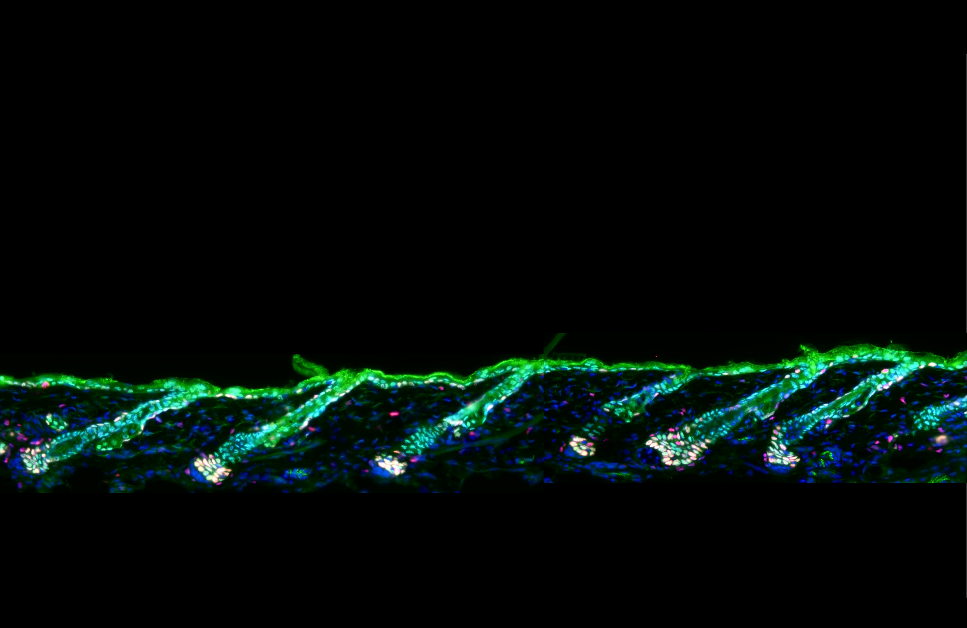
Uncovering transcriptional profile changes in hair follicle melanocytes under stress
Lanqi Huang & Jonathan Li

Slide 2
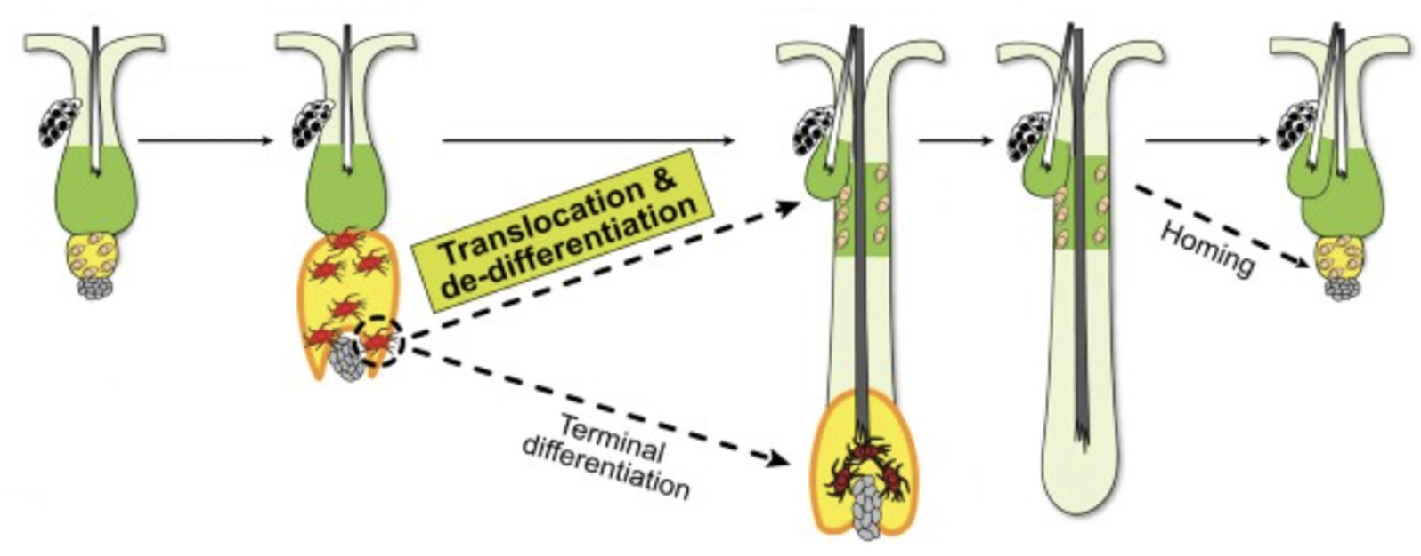
The Hair Cycle and the Melanocytes’ Dynamic Niche
Quiescence Growth → → → → → → → → → Regression → Quiescence
MeSCs
Melanocyte Stem Cells (MeSCs)
MeSCs
TA cells
Sun et al., 2023
Mature Melanocytes

Slide 3
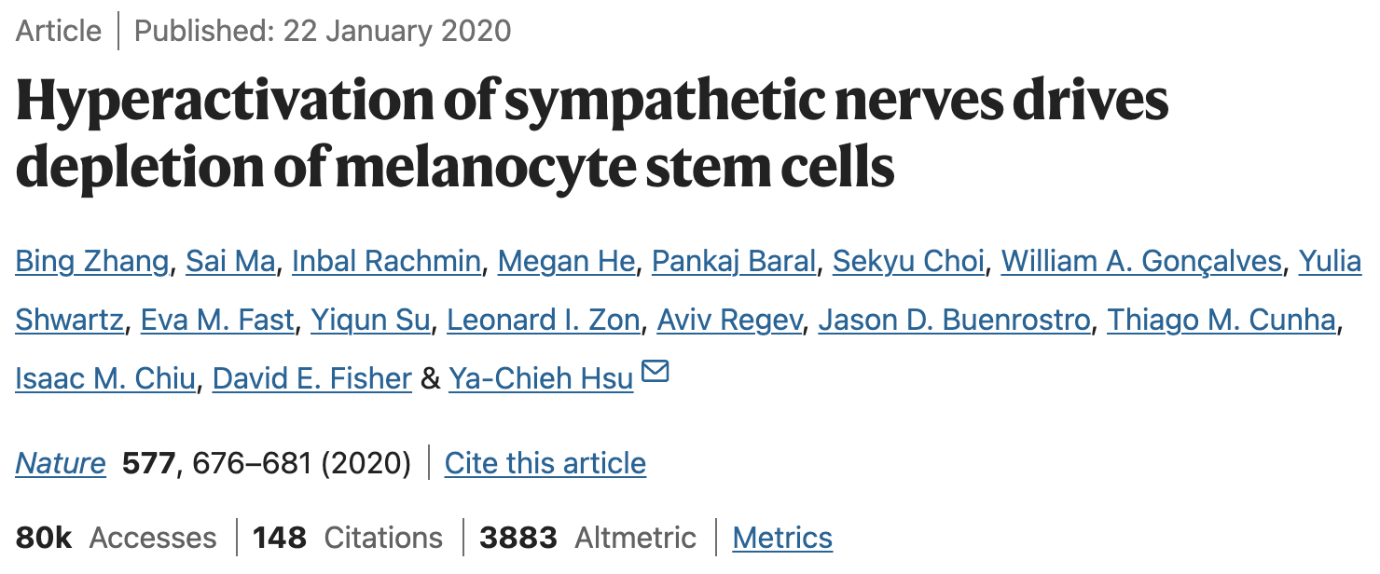
Where our dataset comes from

Slide 4
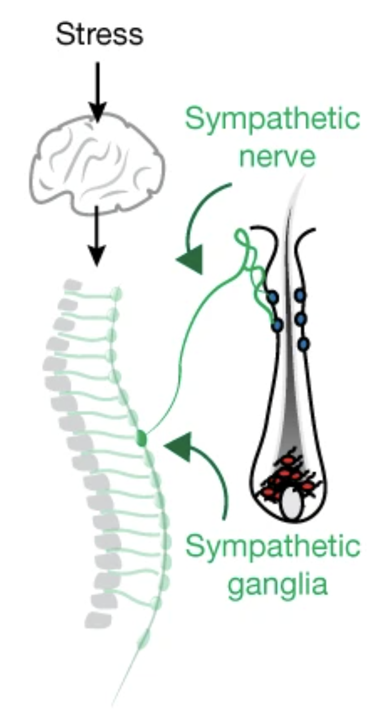
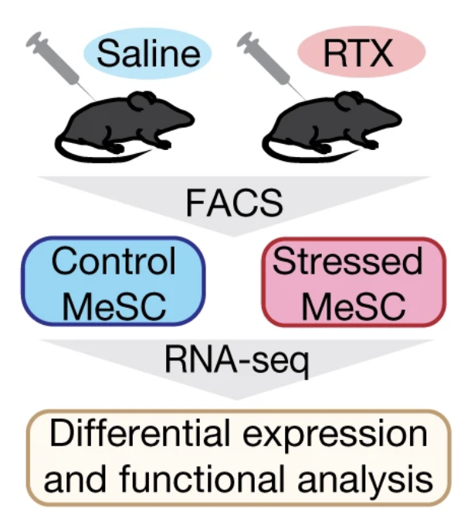
Experimental Design and Workflow

Slide 5
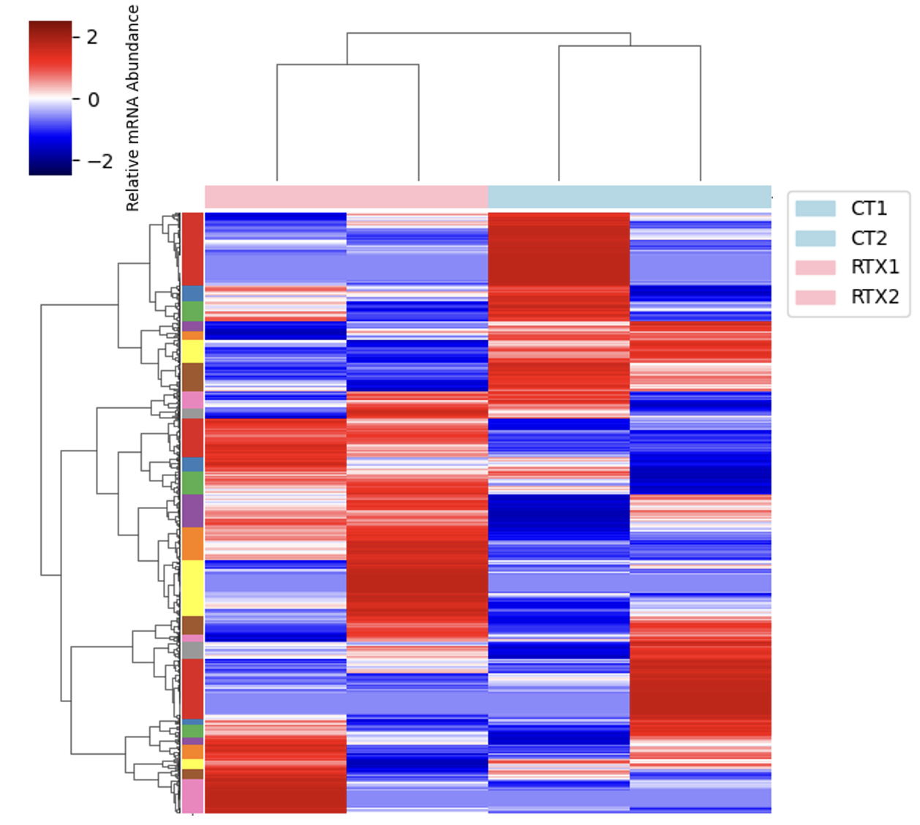
Broad analysis reveals replicate heterogeneity

Slide 6
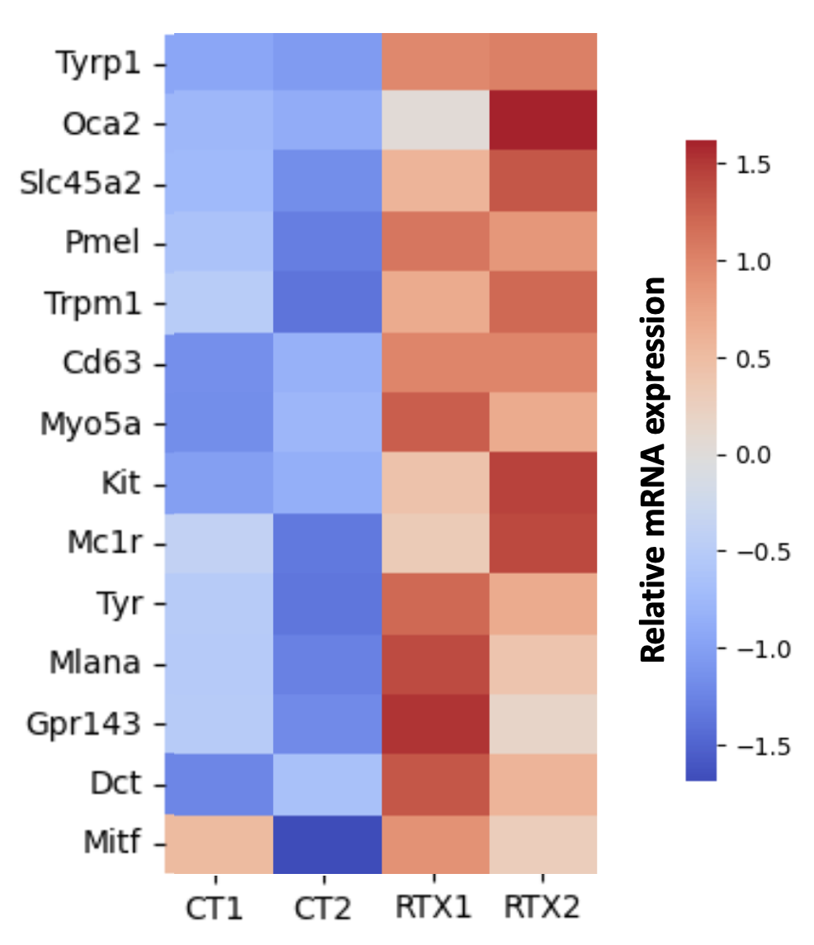
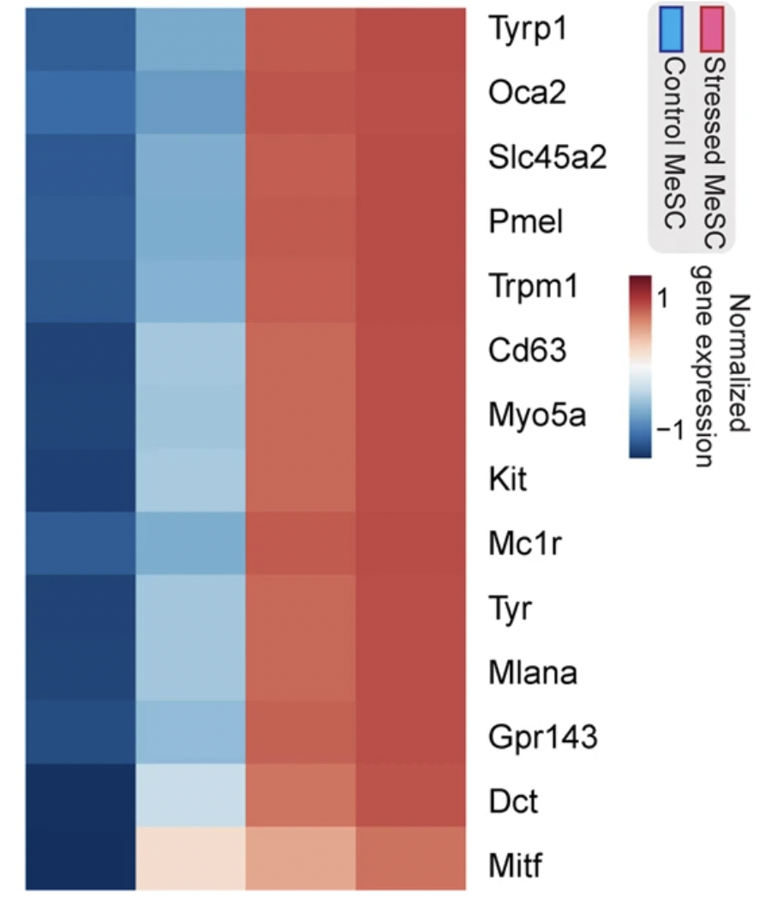
Checking on our retrieved dataset
Sun et al., 2020
Extended Fig. 7e
Our recreation

Slide 7
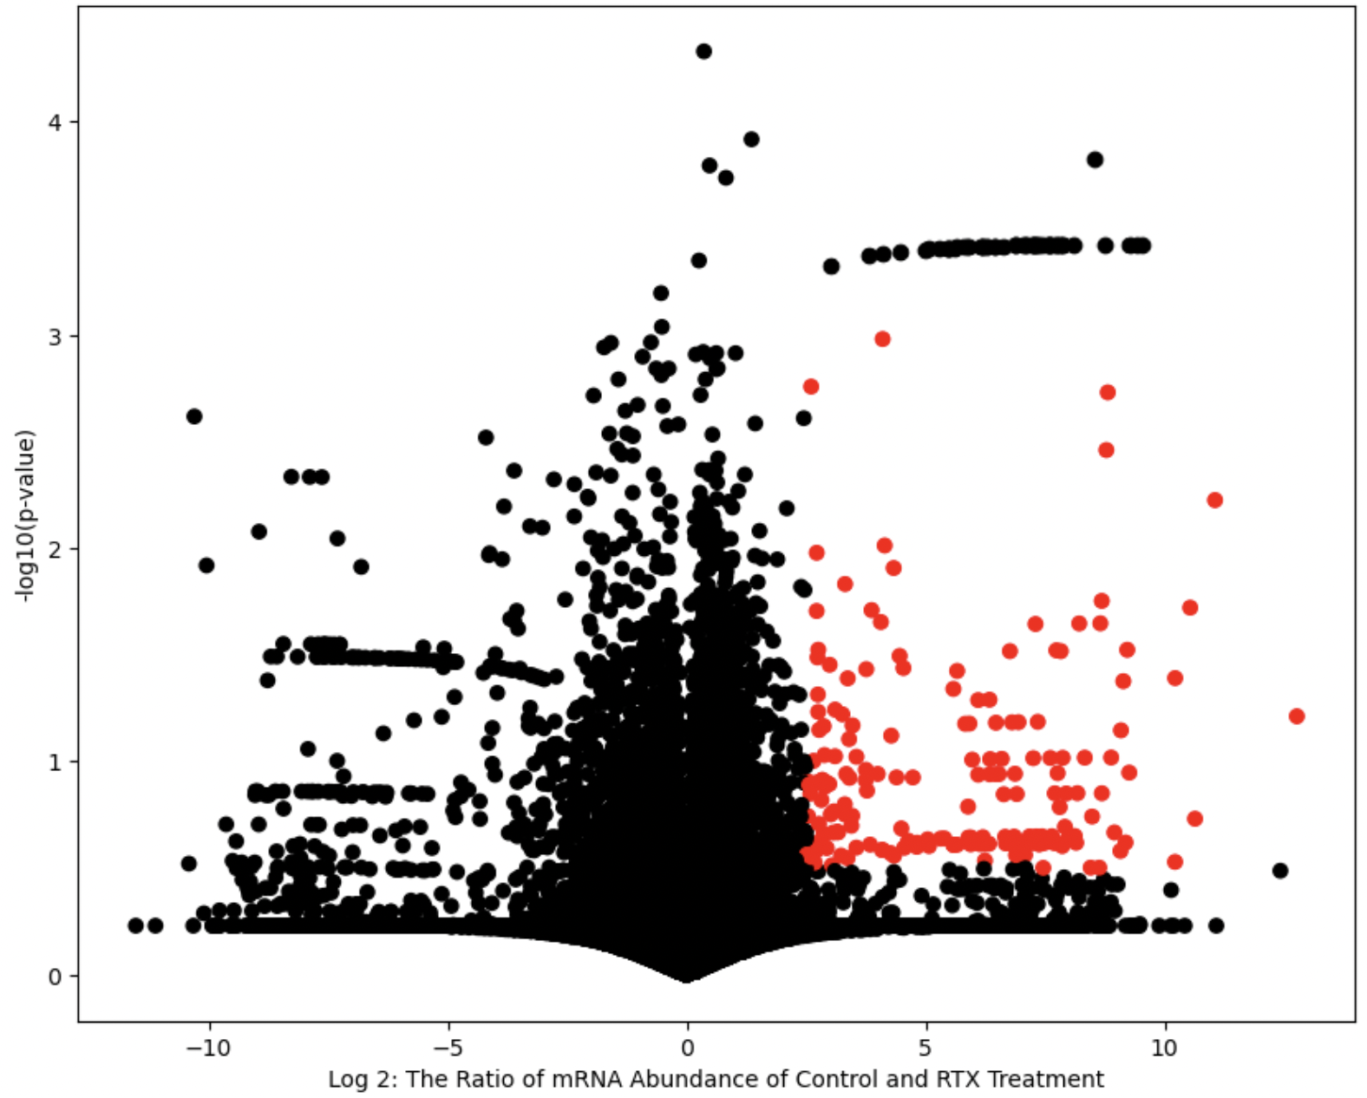
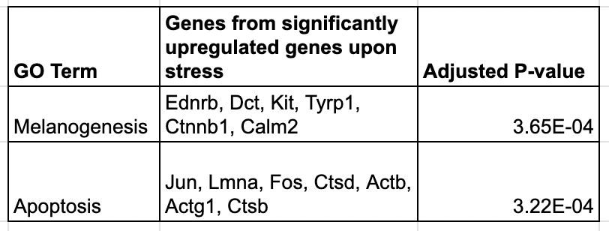
Pathway Enrichment Analysis with EnrichR

Slide 8
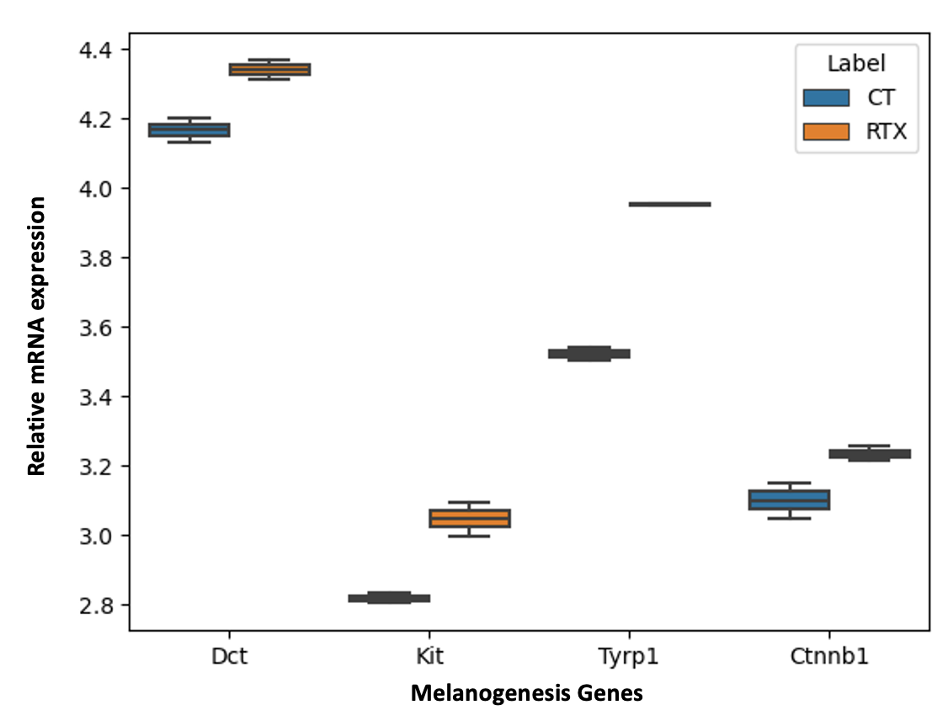



Stress promotes committed fate for MeSCs
Sun et al., 2023

Slide 9
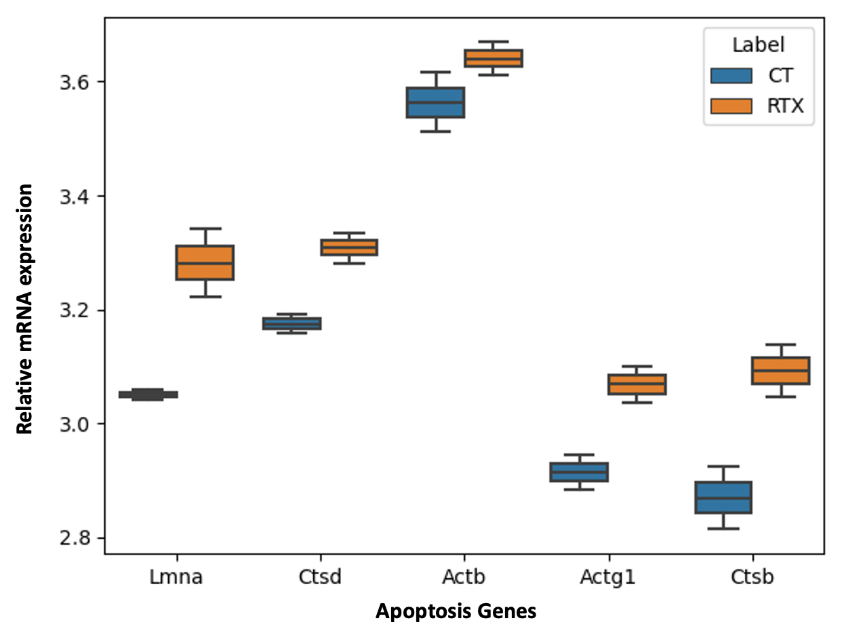
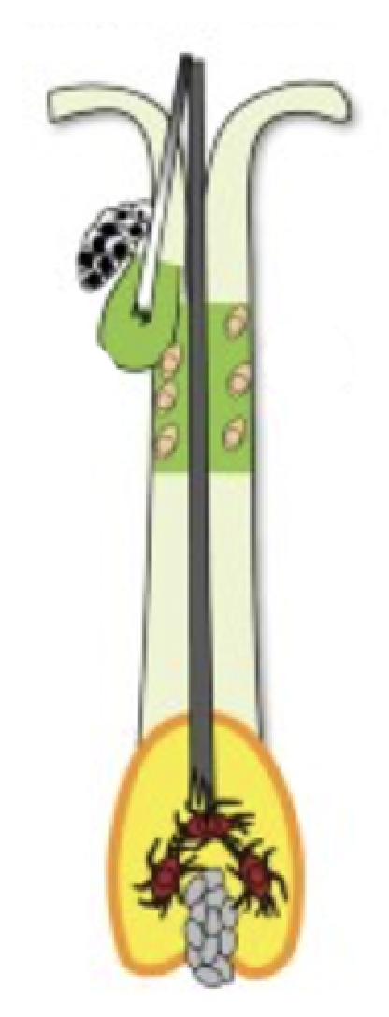
Stressed & committed melanocytes upregulate apoptosis

Slide 10
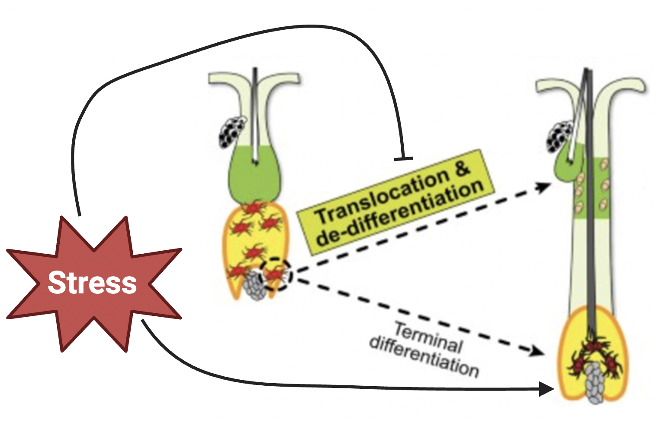
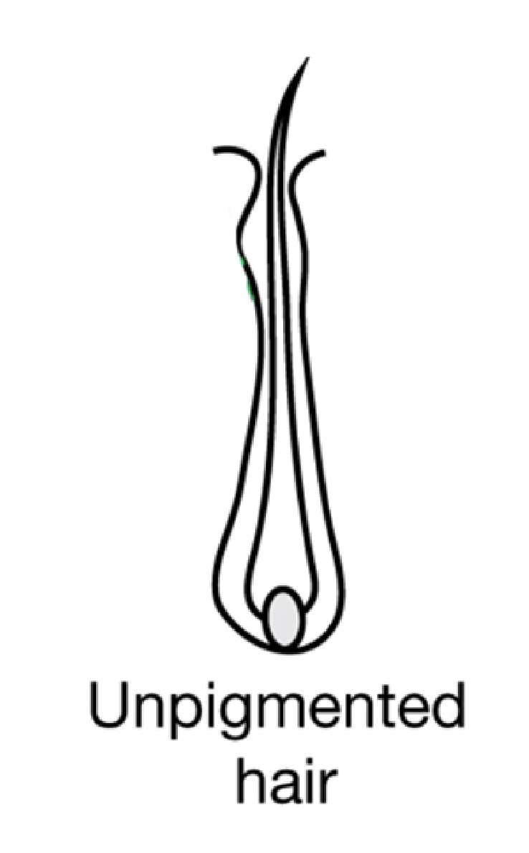
Stress affects two melanocyte populations
Hair Cycle(s)

Slide 11
References
Zhang, B., Ma, S., Rachmin, I. et al. Hyperactivation of sympathetic nerves drives depletion of melanocyte stem cells. Nature 577, 676–681 (2020). https://doi.org/10.1038/s41586-020-1935-3
Sun, Q., Lee, W., Hu, H. et al. Dedifferentiation maintains melanocyte stem cells in a dynamic niche. Nature 616, 774–782 (2023). https://doi.org/10.1038/s41586-023-05960-6

